Slide 1
Online Doubt Support Portal

Slide 2
TABLE OF CONTENTS
01
04
About the Project
Solution Implemented
Major Requirements
02
05
Features to update
03
Problem Faced

Slide 3

ABOUT THE PROJECT
This Portal will help students to solve there doubts by interacting with one or more persons at a time.One can solve doubt by drawing,writing code and by chatting at this portal. This Project is implemented mainly by using JavaScript and some libraries and frameworks of Node.js like Express.js, Socket.IO, HTTP.

Slide 4
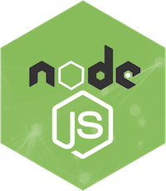


MAJOR REQUIREMENTS
Node.js
HTML, CSS, JavaScript
jQuery
Libraries and frameworks of Node.js like express.js and socket.IO are used.
These are used for the frontend purpose. Bootstrap is used to implement easy styling
jQuery is used to easily implement Javascript written in to serve the backend Purpose.

Slide 5

PROBLEM
Students face problems while discussing their doubts on a chat app or phone call, to solve this problem we have implemented a free resource for them. Many other sketchboards are also available but they do not serve the purpose of writing something and chatting along with the whiteboard.

Slide 6

SOLUTION
We have Solved the mentioned problem of students by designing a portal which consists of all the three major parts needed to solve a doubt. This portal contains a drawing board, code editor and a chat box shown in the next slide.

Slide 7
Web Page Components
1. Drawing Board
2. Code Writer
3. Chat Box

Slide 8
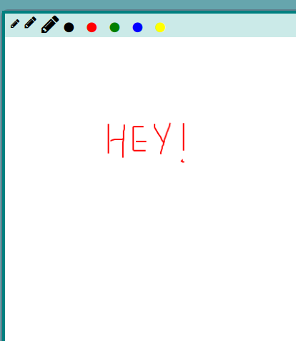
Drawing Board
Drawing board with five color options.
Three marker options.
A clear Board button.

Slide 9
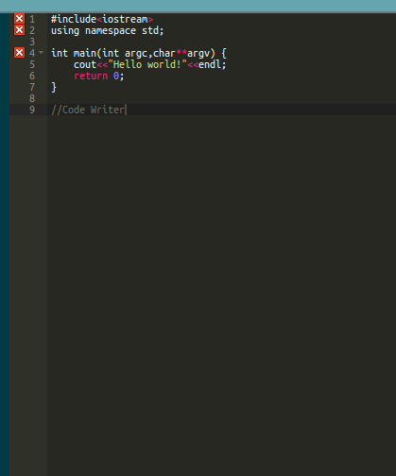
Code Writer
Code or text writer.

Slide 10
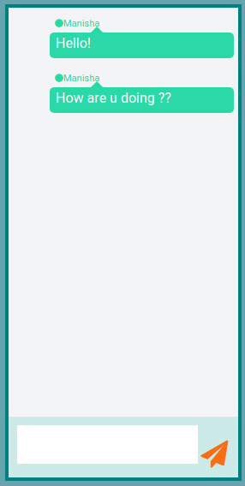
Chat Box
Real time chat Box.

Slide 11
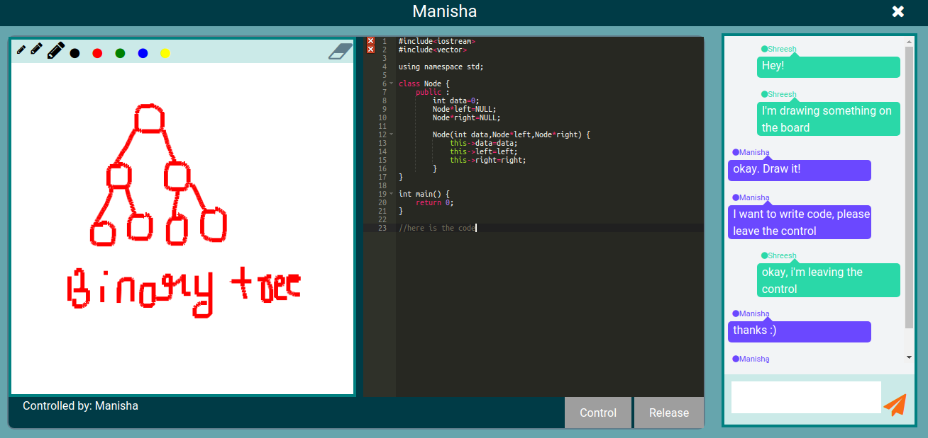
User-1 View

Slide 12
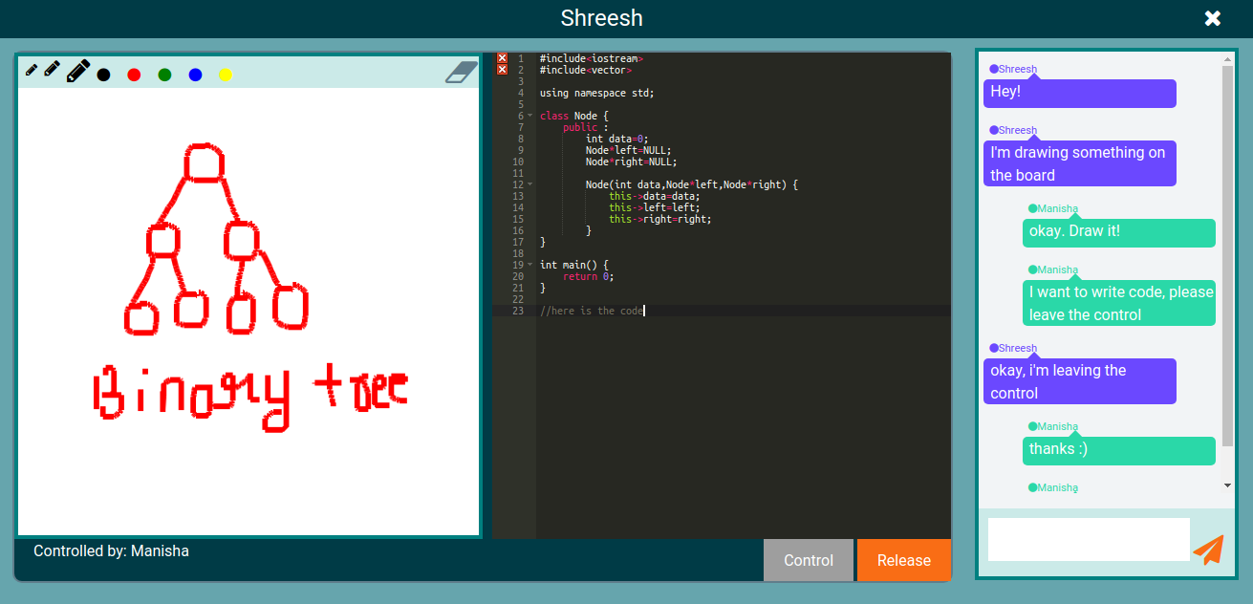
User-2 View

Slide 13
FEATURES TO UPDATE
COMPILATION
PROGRAMMING MISTAKES
LOGIN PAGE
AUDIO CONVERSATION
ANDROID PORTABILITY
DESKTOP SHARING

Slide 14
THANKS!

